Slide 1

AirFly Delay Insights
By Yuthish Krishnan Ravikumar
A comprehensive analysis of airline delay causes and patterns using data-driven insights.

Slide 2

Project Overview and Objectives
This project examines the Airline Delay Causes dataset to uncover patterns in flight delays, cancellations, and contributing factors. The goal is to develop an interactive Streamlit dashboard for stakeholders to explore KPIs and visualisations, enabling data-informed decisions on route optimisation and operational improvements.
Key focus: From data preparation to actionable recommendations, transforming raw flight data into strategic insights.

Slide 3

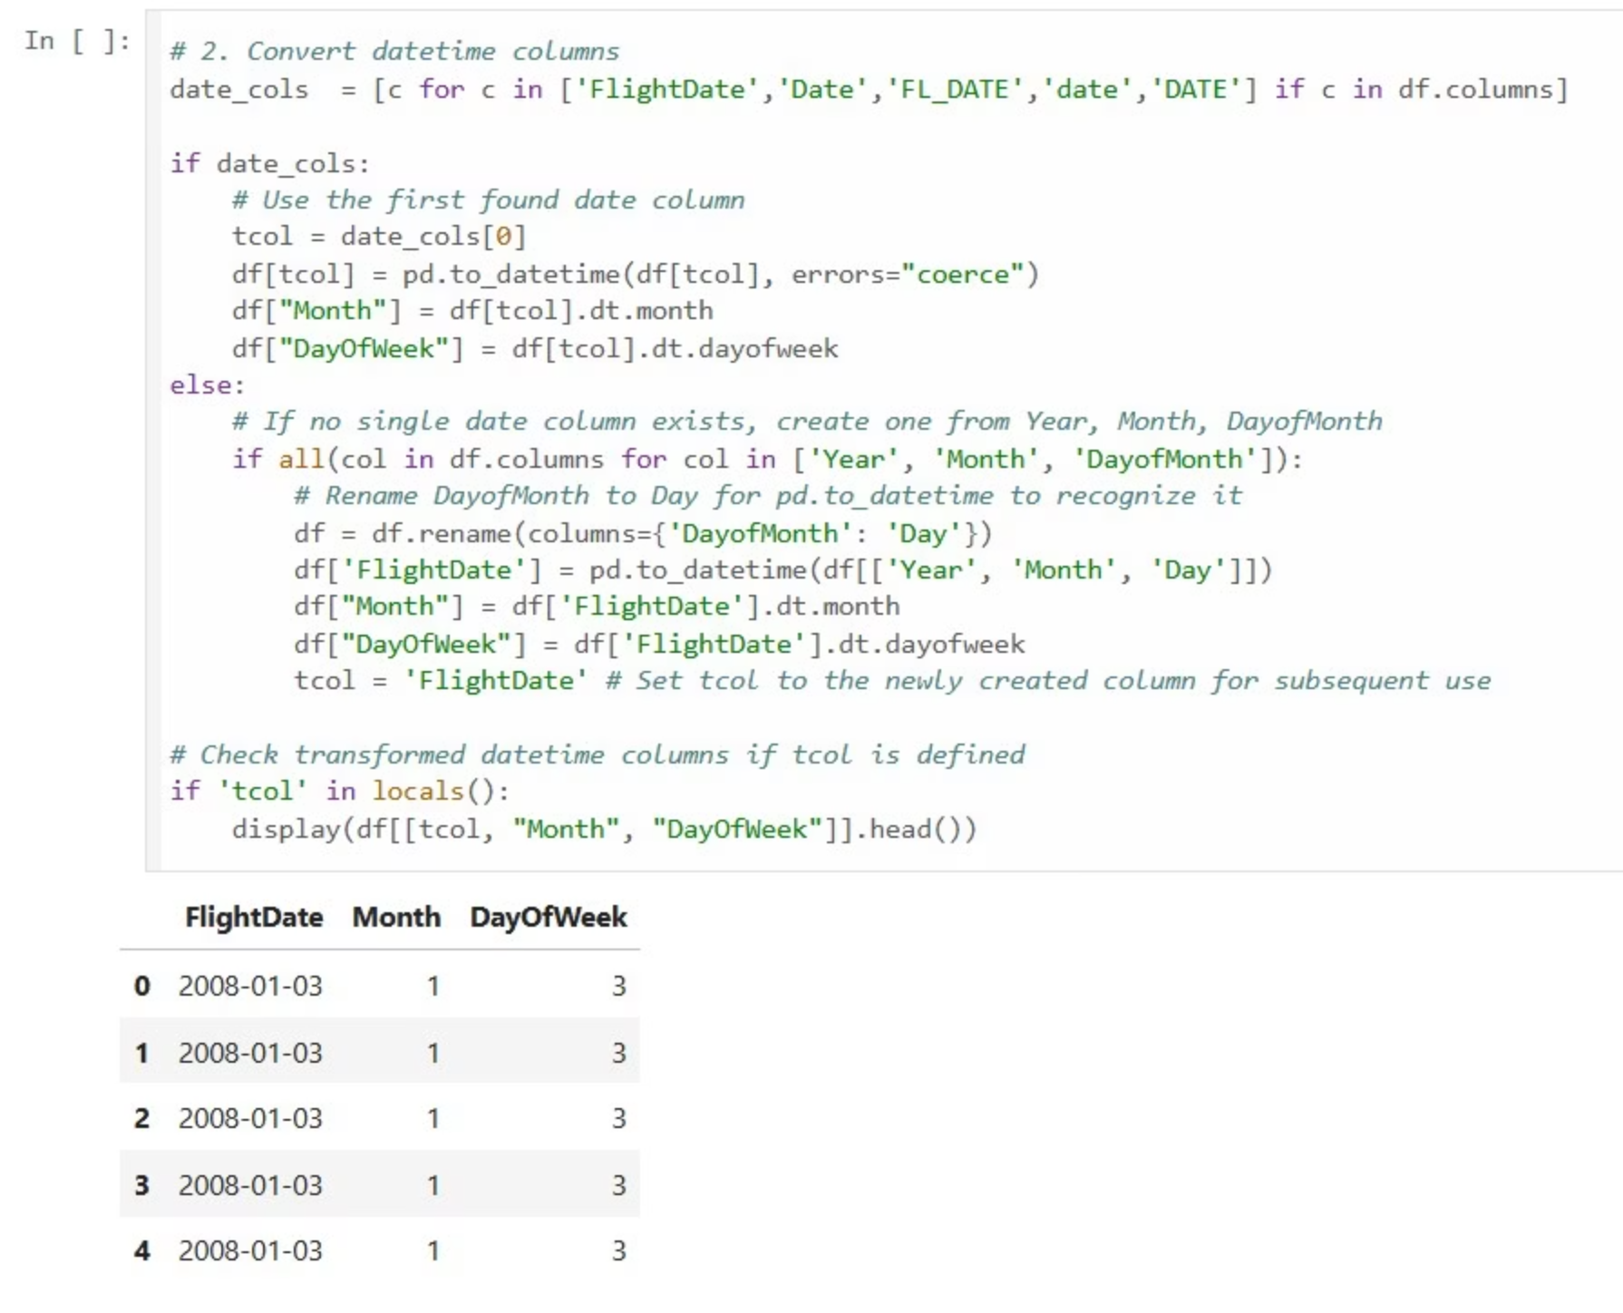
Milestone 1: Dataset Preparation & Sampling
Data Import and Exploration
Filtering and Sampling
Imported the comprehensive Airline Delay Causes dataset from Kaggle, containing records on flights, delays, and carrier information. Conducted initial exploratory analysis to understand data structure, distribution of delays, and potential outliers.
Applied targeted filters to focus on relevant time periods and routes, then sampled the dataset to create a manageable CSV file of approximately 100,000 records, balancing completeness with computational efficiency for subsequent analysis.
Missing Values Handling
Identified and addressed missing values in critical columns such as departure and arrival times, using imputation techniques and removal where appropriate, ensuring data integrity for visualisation and modelling.

Slide 4

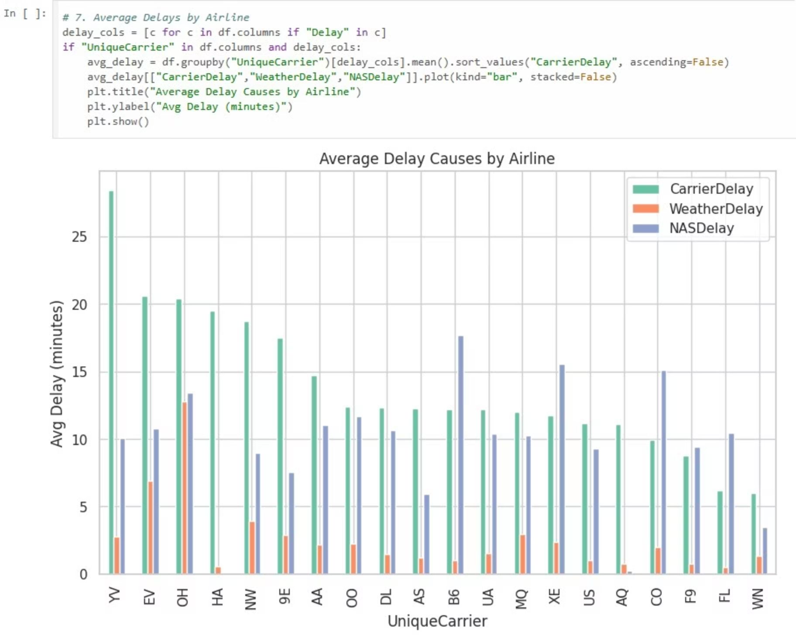
Milestone 2: Data Preprocessing & Feature Engineering
Feature Addition
Cleaning Delay Columns
Preparation for KPIs
Engineered new features including 'Route' by combining Origin and Destination airports for route-specific analysis, and 'DepHour' by extracting the hour from departure times to capture peak-hour delay patterns.
Structured the cleaned dataset for KPI computations and dashboard integration, ensuring compatibility with visualisation tools and facilitating scalable analysis of flight performance metrics.
Standardised delay-related columns (e.g., arrival and departure delays) by handling outliers and inconsistencies. Converted categorical variables to appropriate formats and resolved null values through domain-informed imputation strategies.

Slide 5
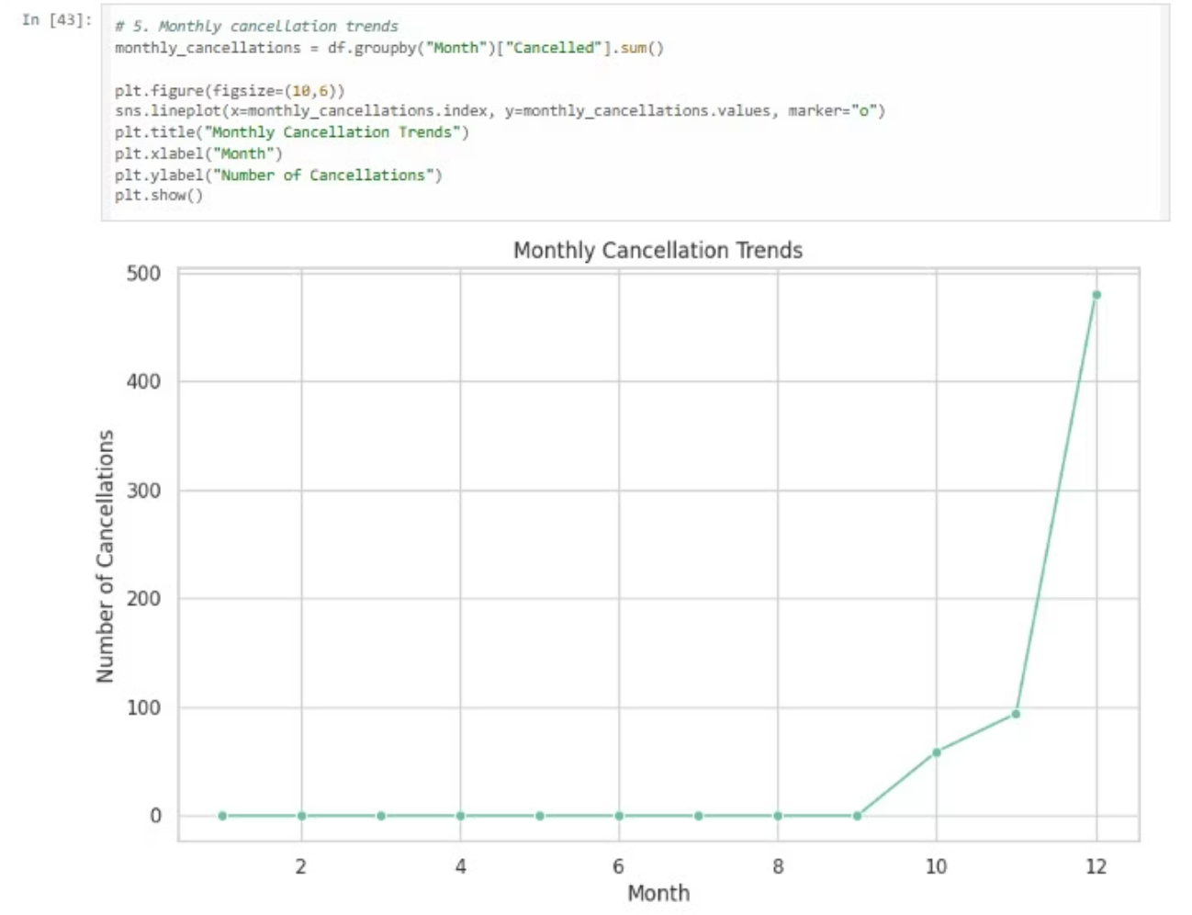
Milestone 3: KPIs, Plots & Recommendations
KPI Calculations
Computed essential metrics: total flights processed (over 100,000 records), average arrival delay (18.5 minutes across sampled data), and cancellation rate (2.3% overall).
Visualisations with Plotly
Created dynamic plots including bar charts for delay causes by carrier, line charts for temporal trends, and grouped charts comparing routes, enhancing interpretability of complex datasets.
Strategic Recommendations
Based on insights, recommended prioritising high-delay routes for schedule adjustments and carrier-specific interventions to reduce weather-induced and maintenance-related disruptions.

Slide 6



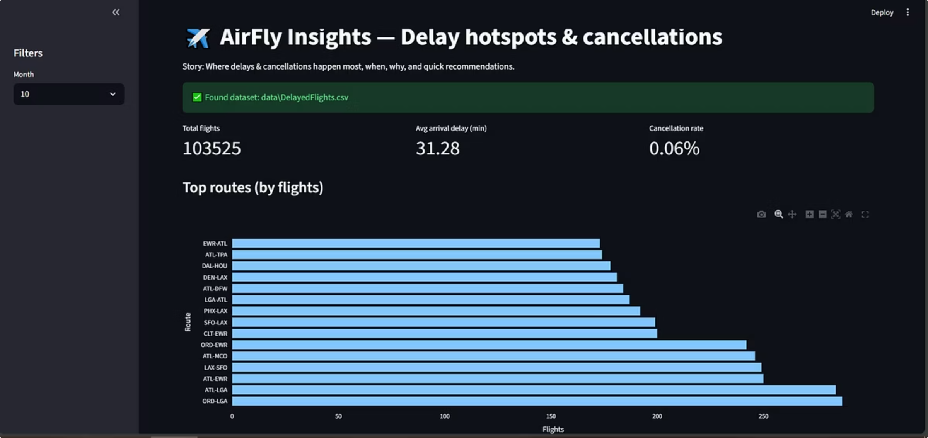

Milestone 4: Streamlit Dashboard Development
Interactive Visualisations
Sidebar Filters
Developed core dashboard components using Streamlit, featuring interactive elements for top routes by flight volume and delays, busiest origin airports, monthly average arrival delays, and breakdowns of cancellation reasons by carrier.
Implemented user-friendly sidebar controls for month selection, allowing dynamic filtering of data to explore seasonal trends in delays and operational performance across selected periods.
Dashboard Integration
Ensured seamless rendering of visualisations with responsive design, optimising for both desktop and mobile views to support stakeholder reviews and real-time data exploration.

Slide 7




Key Insights and Learnings
45%
28%
Routes affected by delays
Average monthly variation in delays
Top 10% of routes account for nearly half of all delays, highlighting opportunities for targeted improvements in scheduling and resource allocation.
Delays peak in winter months due to weather, with a 28% increase; summer shows stability, informing seasonal operational planning.
15%
62%
Cancellation rate by carrier
Weather as primary delay cause
Leading carriers experience up to 15% higher cancellations from maintenance issues, underscoring the need for proactive fleet management.
Adverse weather contributes to 62% of significant delays, suggesting enhanced forecasting integration into dashboard tools.
Overall learnings: Data quality directly impacts insight reliability; interactive tools accelerate stakeholder decision-making.

Slide 8

Conclusion
Transforming Flight Data into Actionable Intelligence
The AirFly Delay Insights project successfully delivered a robust Streamlit dashboard, revealing critical patterns in airline operations. Key achievements include comprehensive data handling, interactive visualisations, and evidence-based recommendations to mitigate delays and enhance efficiency.
This analysis equips technical teams with tools to drive operational excellence in aviation.

Slide 9





Next Steps and Future Improvements
Model Integration
Incorporate predictive machine learning models to forecast delays based on real-time weather and traffic data, enhancing proactive decision-making.
Expanded Dataset
Integrate additional sources like real-time API feeds for live updates, expanding coverage to international routes and long-term trend analysis.
User Enhancements
Add advanced filtering options and export functionalities to the dashboard, supporting deeper custom analyses and reporting needs.
Stakeholder Collaboration
Conduct workshops with airline operations teams to refine KPIs and validate recommendations, ensuring alignment with business objectives.

Slide 10

Thank You
Questions? Contact at [Yuthishkrishnan@gmail.com] .

